Slide 1


Extension Methods, Lambda Expressions and LINQ
Extension Methods, Anonymous Types, Delegates, Lambda Expressions, LINQ, Dynamic
Object-Oriented Programming
Telerik Software Academy
http://academy.telerik.com

Slide 2

Table of Contents
Extension Methods
Anonymous Types
Delegates
Events
Lambda Expressions
LINQ Queries
Dynamic Type

Slide 3

Extension Methods

Slide 4
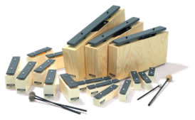
Extension Methods
Once a type is defined and compiled into an assembly its definition is, more or less, final
The only way to update, remove or add new members is to recode and recompile the code
Extension methods allow existing compiled types to gain new functionality
Without recompilation
Without touching the original assembly

Slide 5
Defining Extension Methods
Extension methods
Defined in a static class
Defined as static
Use this keyword before its first argument to specify the class to be extended
Extension methods are "attached" to the extended class
Can also be called from statically through the defining static class

Slide 6
Extension Methods – Examples
public static class Extensions
{
public static int WordCount(this string str)
{
return str.Split(new char[] { ' ', '.', '?' },
StringSplitOptions.RemoveEmptyEntries).Length;
}
}
...
static void Main()
{
string s = "Hello Extension Methods";
int i = s.WordCount();
Console.WriteLine(i);
}

Slide 7
Extension Methods – Examples (2)
public static void IncreaseWidth(
this IList<int> list, int amount)
{
for (int i = 0; i < list.Count; i++)
{
list[i] += amount;
}
}
// ...
static void Main()
{
List<int> ints =
new List<int> { 1, 2, 3, 4, 5 };
ints.IncreaseWidth(5); // 6, 7, 8, 9, 10
}

Slide 8

Extension Methods
Live Demo

Slide 9

Anonymous Types

Slide 10
Anonymous Types
Anonymous types
Encapsulate a set of read-only properties and their value into a single object
No need to explicitly define a type first
To define an anonymous type
Use of the new var keyword in conjunction with the object initialization syntax
var point = new { X = 3, Y = 5 };

Slide 11
Anonymous Types – Example
// Use an anonymous type representing a car
var myCar =
new { Color = "Red", Brand = "BMW", Speed = 180 };
Console.WriteLine("My car is a {0} {1}.",
myCar.Color, myCar.Brand);
At compile time, the C# compiler will autogenerate an uniquely named class
The class name is not visible from C#
Using implicit typing (var keyword) is mandatory

Slide 12
Anonymous Types – Properties
Anonymous types are reference types directly derived from System.Object
Have overridden version of Equals(), GetHashCode(), and ToString()
Do not have == and != operators overloaded
var p = new { X = 3, Y = 5 };
var q = new { X = 3, Y = 5 };
Console.WriteLine(p == q); // false
Console.WriteLine(p.Equals(q)); // true

Slide 13
Arrays of Anonymous Types
You can define and use arrays of anonymous types through the following syntax:
var arr = new[] { new { X = 3, Y = 5 },
new { X = 1, Y = 2 }, new { X = 0, Y = 7 } };
foreach (var item in arr)
{
Console.WriteLine("({0}, {1})",
item.X, item.Y);
}

Slide 14

Anonymous Types
Live Demo

Slide 15
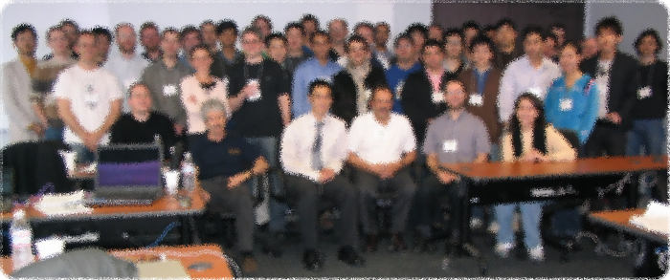

Delegates in .NET Framework

Slide 16
What are Delegates?
Delegates are special .NET types that hold a method reference
Describe the signature of given method
Number and types of the parameters
The return type
Their "values" are methods
These methods match their signature (parameters and return types)
Delegates are reference types

Slide 17
What are Delegates? (2)
Delegates are roughly similar to function pointers in C and C++
Strongly-typed pointer (reference) to a method
Pointer (address) to a callback function
Can point to static and instance methods
Can point to a sequence of multiple methods
Known as multicast delegates
Used to perform callback invocations
Implement the "publish-subscribe" model

Slide 18
Delegates – Example
// Declaration of a delegate
public delegate void SimpleDelegate(string param);
public class DelegatesExample
{
static void TestMethod(string param)
{
Console.WriteLine("I was called by a delegate.");
Console.WriteLine("I got parameter: {0}.", param);
}
static void Main()
{
// Instantiate the delegate
SimpleDelegate d = new SimpleDelegate(TestMethod);
// Invocation of the method, pointed by delegate
d("test");
}
}

Slide 19

Simple Delegate
Live Demo

Slide 20
Generic and Multicast Delegates
A delegate can be generic:
Using a generic delegate:
The above can simplified as follows:
Delegates are multicast (can hold multiple methods), assigned through the += operator:
public delegate void SomeDelegate<T>(T item);
public static void Notify(int i) { … }
SomeDelegate<int> d = new SomeDelegate<int>(Notify);
SomeDelegate<int> d = Notify;
d += Notify;

Slide 21
Anonymous Methods
Anonymous methods are methods without name
Can take parameters and return values
Declared through the delegate keyword
class SomeClass
{
delegate void SomeDelegate(string str);
static void Main()
{
SomeDelegate d = delegate(string str)
{
MessageBox.Show(str);
};
d("Hello");
}
}

Slide 22
Multicast Delegates – Example
delegate int StringDelegate<T>(T value);
public class MultiDelegates
{
static int PrintString(string str)
{
Console.WriteLine("Str: {0}", str);
return 1;
}
int PrintStringLength(string value)
{
Console.WriteLine("Length: {0}", value.Length);
return 2;
}
public static void Main()
{
StringDelegate<string> d = MultiDelegates.PrintString;
d += new MultiDelegates().PrintStringLength;
int result = d("some string value");
Console.WriteLine("Returned result: {0}", result);
}
}

Slide 23
Predefined Delegates
Predefined delegates in .NET:
Action<T1, T2, T3> - generic predefined void delegate with parameters of types T1, T2 and T3
Func<T1, T2, TResult> - generic predefined delegate with return value of type TResult
Both have quite a lot of overloads
Func<string, int> predefinedIntParse = int.Parse;
int number = predefinedIntParse("50");
Action<object> predefinedAction = Console.WriteLine;
predefinedAction(1000);

Slide 24

Multicast Generic Delegate
Live Demo

Slide 25


Events

Slide 26
Events
A message sent by an object to signal the occurrence of an action
Enable a class or object to notify other classes or objects when something of interest occurs
Publisher/event sender – the class that sends/raises the event
Doesn’t know which object/method will handle the event
Subscribers – the classes that receive/handle the event
In the .NET events are based on the EventHandler delegate and the EventArgs base class

Slide 27
Define Events
Use event keyword
Specify type of delegate for the event – EventHandler
Add a protected virtual method
Name the method On[EventName]
class Counter {
public event EventHandler ThresholdReached;
protected virtual void OnThresholdReached(EventArgs e) {
if (this.ThresholdReached != null) {
this.ThresholdReached(this, e);
}
}
// provide remaining implementation for the class
}

Slide 28
Event Data
Data that is associated with an event can be provided through an event data class
EventArgs class is the base type for all event data classes
Also used when an event does not have any data associated with it
Naming of the data class – [Name]EventArgs
public class ThresholdReachedEventArgs : EventArgs
{
public int Threshold { get; set; }
public DateTime TimeReached { get; set; }
}

Slide 29
Event Handlers
To respond to an event, you define an event handler method
Must match the signature of the delegate
class Program {
static void Main() {
Counter counter = new Counter();
counter.ThresholdReached += CounterThresholdReached;
// provide remaining implementation for the class
}
static void CounterThresholdReached(
object sender, EventArgs e) {
Console.WriteLine("The threshold was reached.");
}
}

Slide 30
Events
Live Demo

Slide 31
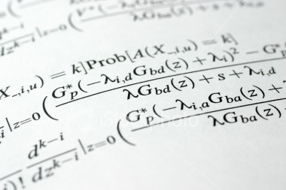
Lambda Expressions

Slide 32
Lambda Expressions
A lambda expression is an anonymous function containing expressions and statements
Used to create delegates or expression tree types
Lambda expressions
Use the lambda operator =>
Read as "goes to"
The left side specifies the input parameters
The right side holds the expression or statement
Link: Lambda notation vs delegate keyword

Slide 33
Lambda Expressions – Examples
Usually used with collection extension methods like FindAll() and RemoveAll()
List<int> list = new List<int>() { 1, 2, 3, 4 };
List<int> evenNumbers =
list.FindAll(x => (x % 2) == 0);
foreach (var num in evenNumbers)
{
Console.Write("{0} ", num);
}
Console.WriteLine();
// 2 4
list.RemoveAll(x => x > 3); // 1 2 3

Slide 34
Sorting with Lambda Expression
var pets = new Pet[]
{
new Pet { Name="Sharo", Age=8 },
new Pet { Name="Rex", Age=4 },
new Pet { Name="Strela", Age=1 },
new Pet { Name="Bora", Age=3 }
};
var sortedPets = pets.OrderBy(pet => pet.Age);
foreach (Pet pet in sortedPets)
{
Console.WriteLine("{0} -> {1}",
pet.Name, pet.Age);
}

Slide 35
Lambda Code Expressions
Lambda code expressions:
List<int> list = new List<int>()
{ 20, 1, 4, 8, 9, 44 };
// Process each argument with code statements
List<int> evenNumbers = list.FindAll((i) =>
{
Console.WriteLine("value of i is: {0}", i);
return (i % 2) == 0;
});
Console.WriteLine("Here are your even numbers:");
foreach (int even in evenNumbers)
Console.Write("{0}\t", even);

Slide 36
Delegates Holding Lambda Functions
Lambda functions can be stored in variables of type delegate
Delegates are typed references to functions
Standard function delegates in .NET:
Func<TResult>, Func<T, TResult>, Func<T1, T2, TResult>, …
Func<bool> boolFunc = () => true;
Func<int, bool> intFunc = (x) => x < 10;
if (boolFunc() && intFunc(5))
Console.WriteLine("5 < 10");

Slide 37
Predicates
Predicates are predefined delegates with the following signature
Define a way to check if an object meets some Boolean criteria
Similar to Func<T, bool>
Used by many methods of Array and List<T> to search for an element
For example List<T>.FindAll(…) retrieves all elements meeting the criteria
public delegate bool Predicate<T>(T obj)

Slide 38
Predicates – Example
List<string> towns = new List<string>()
{
"Sofia", "Plovdiv", "Varna", "Sopot", "Silistra"
};
List<string> townsWithS =
towns.FindAll(delegate(string town)
{
return town.StartsWith("S");
});
// A short form of the above (with lambda expression)
List<string> townsWithS =
towns.FindAll((town) => town.StartsWith("S"));
foreach (string town in townsWithS)
{
Console.WriteLine(town);
}

Slide 39

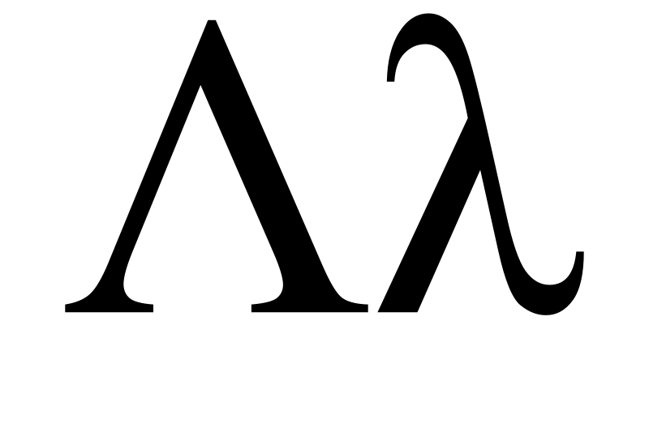
Lambda Expressions
Live Demo

Slide 40
Action<T> and Func<T>
Action<T> - void delegate with parameter T
Func<T, TResult> - result delegate returning T
Action<int> act = (number) =>
{
Console.WrileLine(number); }
act(10); // logs 10
Func<string, int, string> greet = (name, age) =>
{
return "Name: " + name + "Age: " + age;
}
Console.WriteLine(greet("Ivaylo", 10));

Slide 41

Action<T> and Func<T>
Live Demo

Slide 42



LINQ and Query Keywords
LINQ

Slide 43
LINQ Building Blocks (2)
LINQ is a set of extensions to .NET Framework
Encompasses language-integrated query, set, and transform operations
Consistent manner to obtain and manipulate "data" in the broad sense of the term
Query expressions can be defined directly within the C# programming language
Used to interact with numerous data types
Converted to expression trees at compile time and evaluated at runtime

Slide 44





LINQ to *
C#
VB.NET
Others …
.NET Language-Integrated Query (LINQ)
LINQ enabled data sources
LINQ enabled ADO.NET
LINQ to Objects
LINQ to DataSets
LINQ
to SQL
LINQ to
Entities
LINQ
to XML
<book>
<title/>
<author/>
<price/>
</book>
Objects
Relational Data
XML

Slide 45
LINQ and Query Keywords
Language Integrated Query (LINQ) query keywords
from – specifies data source and range variable
where – filters source elements
select – specifies the type and shape that the elements in the returned sequence
group – groups query results according to a specified key value
orderby – sorts query results in ascending or descending order

Slide 46

Query Keywords – Examples
select, from and where clauses:
int[] numbers = { 5, 4, 1, 3, 9, 8, 6, 7, 2, 0 };
var querySmallNums =
from num in numbers
where num < 5
select num;
foreach (var num in querySmallNums)
{
Console.Write(num.ToString() + " ");
}
// The result is 4 1 3 2 0

Slide 47

Query Keywords – Examples (2)
Nested queries:
string[] towns =
{ "Sofia", "Varna", "Pleven", "Ruse", "Bourgas" };
var townPairs =
from t1 in towns
from t2 in towns
select new { T1 = t1, T2 = t2 };
foreach (var townPair in townPairs)
{
Console.WriteLine("({0}, {1})",
townPair.T1, townPair.T2);
}

Slide 48

Query Keywords – Examples (3)
Sorting with оrderby:
string[] fruits =
{ "cherry", "apple", "blueberry", "banana" };
// Sort in ascending sort
var fruitsAscending =
from fruit in fruits
orderby fruit
select fruit;
foreach (string fruit in fruitsAscending)
{
Console.WriteLine(fruit);
}

Slide 49
Standard Query Operators – Example
string[] games = {"Morrowind", "BioShock", "Half Life",
"The Darkness", "Daxter", "System Shock 2"};
// Build a query expression using extension methods
// granted to the Array via the Enumerable type
var subset = games .Where(game => game.Length > 6) .OrderBy(game => game) .Select(game => game);
foreach (var game in subset)
Console.WriteLine(game);
var subset =
from g in games
where g.Length > 6
orderby g
select g;

Slide 50
Counting the Occurrences of a Word in a String – Example
string text = "Historically, the world of data ...";
// …
string searchTerm = "data";
string[] source = text.Split(
new char[] { '.', '?', '!', ' ', ';', ':', ',' },
StringSplitOptions.RemoveEmptyEntries);
// Use ToLower() to match both "data" and "Data"
var matchQuery =
from word in source
where word.ToLower() == searchTerm.ToLower()
select word;
int wordCount =
matchQuery.Count();
int wordCount = source.Select(
w => w.toLower() ==
searchTerm.ToLower()).Count();

Slide 51
Querying Arrays
Any kind of arrays can be used with LINQ
Can be even an untyped array of objects
Queries can be applied to arrays of custom objects
Example:
var titles =
from b in books
where b.Title.Contains("Action")
select b.Title;
Book[] books = {
new Book { Title="LINQ in Action" },
new Book { Title="LINQ for Fun" },
new Book { Title="Extreme LINQ" } };
var titles = books
.Where(book => book.Title.Contains("Action"))
.Select(book => book.Title);

Slide 52
Querying Generic Lists
The previous example can be adapted to work with a generic list
List<T>, LinkedList<T>, Queue<T>, Stack<T>, HashSet<T>, etc.
List<Book> books = new List<Book>() {
new Book { Title="LINQ in Action" },
new Book { Title="LINQ for Fun" },
new Book { Title="Extreme LINQ" } };
var titles = books
.Where(book => book.Title.Contains("Action"))
.Select(book => book.Title);

Slide 53
Querying Strings
Although System.String may not be perceived as a collection at first sight
It actually is a collection, because it implements IEnumerable<char>
String objects can be queried with LINQ to Objects, like any other collection
var count = "Non-letter characters in this string: 8"
.Where(c => !Char.IsLetter(c))
.Count();
Console.WriteLine(count);
// The result is: 8
var count =
(from c in "Non-letter…"
where !Char.IsLetter(c)
select c).Count();

Slide 54
Operations
Where()
Searches by given condition
First()/FirstOrDefault()
Gets the first matched element
Last()/LastOrDefault()
Gets the last matched element
Select()/Cast()
Makes projection (conversion) to another type
OrderBy()/ThenBy()/OrderByDescending()
Orders a collection

Slide 55
Operations
Any()
Checks if any element matches a condition
All()
Checks if all element matches a condition
ToArray()/ToList()/AsEnumerable()
Converts the collection type
Reverse()
Reverses a collection

Slide 56
Aggregation Methods
Average()
Calculates the average value of a collection
Count()
Counts the elements in a collection
Max()
Determines the maximum value in a collection
Sum()
Sums the values in a collection

Slide 57
Aggregation Methods – Examples
Count(<condition>)
Max()
double[] temperatures =
{ 28.0, 19.5, 32.3, 33.6, 26.5, 29.7 };
int highTempCount = temperatures.Count(p => p > 30);
Console.WriteLine(highTempCount);
// The result is: 2
var highTemp =
(from p in temperatures
where p > 30
select p).Count();
double[] temperatures =
{ 28.0, 19.5, 32.3, 33.6, 26.5, 29.7 };
double maxTemp = temperatures.Max();
Console.WriteLine(maxTemp);
// The result is: 33.6
var highTemp =
(from p in temperatures
select p).Max();

Slide 58

LINQ Query Keywords
LINQ
Live Demo

Slide 59


Dynamic Type

Slide 60
Dynamic Type
The Dynamic type is
Defined with the dynamic keyword
Can hold everything (different from object)
Evaluated at runtime
Example:
dynamic dyn = 5;
dyn = "Some text";
dyn = new Student();
dyn.Name = "Ivan";
dyn = new[] { 5, 8, 10 };

Slide 61

Dynamic Type
Live Demo

Slide 62
Extension Methods, Lambda Expressions and LINQ
http://academy.telerik.com

Slide 63




Free Trainings @ Telerik Academy
C# Programming @ Telerik Academy
csharpfundamentals.telerik.com
Telerik Software Academy
academy.telerik.com
Telerik Academy @ Facebook
facebook.com/TelerikAcademy
Telerik Software Academy Forums
forums.academy.telerik.com

